Slide 2
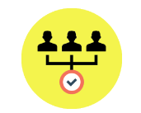
THE AGENCY IMPERATIVE
Reporting challenges-Handling multiple clients
Wide range of client data sources
Meaningful reporting requires automatically pulling data out from multiple end-points including SEO tools, Web Analytics, AdWords, Email Marketing, CRM etc.
Excel limitations
Complex data transformations, automated data refresh, third party lookups etc. not possible
Productivity constraints
In-ordinate amounts of time spent on manual report compilation. Not scalable as client requirements or number of clients grows

Slide 3
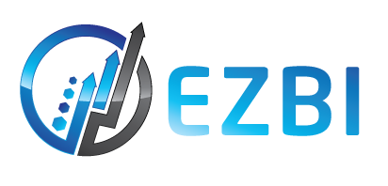
Introducing eZBI
Cloud hosted BI using PowerBI Embedded
Automated Data Integration
Automatically pulls data from over 25 digital marketing tools into a central database
Advanced visualizations
Allow clients web based access to their own dashboards. Insightful reports built by PowerBI specialists
Flexible pricing
Monthly pricing with long term contracts. No PowerBI licence costs, user count of data size constraints

Slide 4
Key features
Why ezBI
Real-time intelligence
Multi-tenant application
Granular access control
Supports Direct Query mode in PowerBI. No need for manually republishing reports for every data refresh cycle
Add unlimited number of clients and users per client-all for a fixed monthly fee
Easily control which user gets to see what content using role based access control
Threshold alerts
Automated client reports
Highly cost-effective
Setup rules based alerts for key metrics and get real-time notifications when thresholds exceeded
Configure automated pdf emails with period reports to be emailed directly to clients
One single monthly fee based on number of clients. No other software/hardware license costs

Slide 5
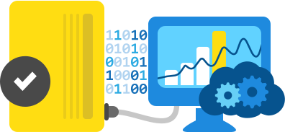
ezBI Architecture components
What makes up ezBI
Data processor
Automatically downloads and processes data from client systems into a centralized Azure SQL server database
Client Frontend
Web based dashboard that allows clients to see only their reports
Admin Frontend
Allows Agency Admin to add and manage clients and users. Allows viewing client reports from a single login

Slide 6
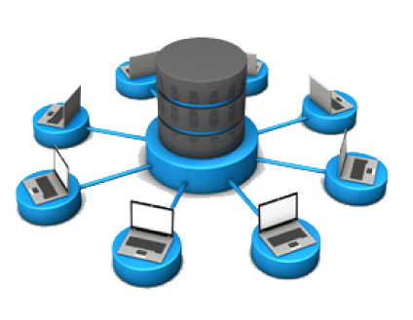
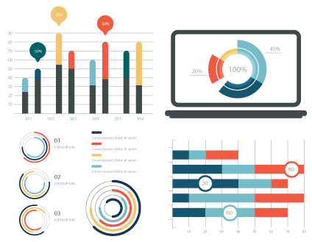
TWO Engagement Models
Platform access only
Multi-user access to ezBI platform
Agency creates and manages its own dashboards and Azure setup
Fixed monthly price (starting at $100/month for 5 clients)
Full service
ezBI platform access
Consultancy support for setting up Azure platform
PowerBI embedded development and integration
Monthly retainer based pricing(starting at $3500/month)

Slide 7
OUR CLIENTS
Selection of clients we serve

