Slide 2
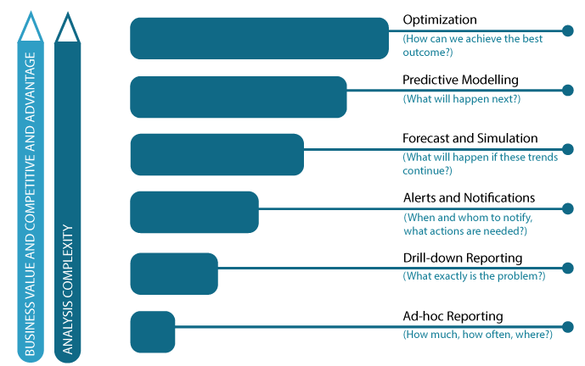
Measurement Maturity Levels
The Capability View
A maturity level defines a combination of tools, resource capabilities and processes that collectively qualify the business value generated from measurement
6 maturity levels
Maturity levels help companies maintain a roadmap for increasing business value from measurement

Slide 3
Implementing measurement
Architecture challenges
Which tools/capabilities to adopt at each maturity level?
How to develop a measurement technology roadmap that provides a 2/3 yr. technology on-boarding plan?
How to decouple project based, tactical implementations from strategic technology direction?

Slide 4
Our Solution
A 3 step architecture
development method

Slide 5
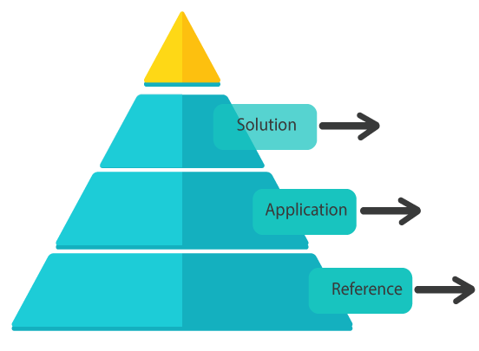
3 Architecture Levels
Modularized Measurement Architectures
Specific to a client/maturity level and project
Derived from Reference Architecture and specific to a maturity level
Company/Maturity level independent. Generic repository of business intelligence technology capabilities

Slide 6
Reference Architecture
What is it?
Overarching Technology Blueprint capturing all possible technology capabilities
Organizes technology requirements into abstract ‘layers’ comprised of ‘building blocks’
Each measurement maturity level comprises of a combination of specific building blocks
Why have it?
Helps align technology investments to business needs
Helps maintain a strategic vision while focusing on a tactical execution plan
Greatly simplifies technology procurement

Slide 7
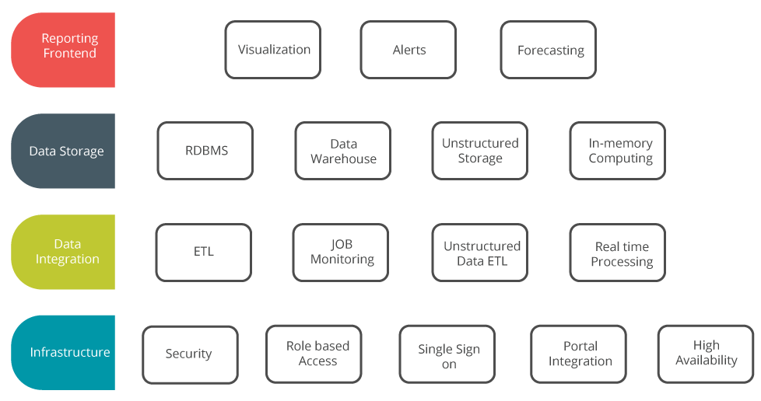
Reference Architecture
16 Architecture building blocks organized in 4 layers

Slide 8
The 4 layers
Conceptual ‘bundling’ of technology capabilities
Infrastructure
All capabilities for physically hosting the final reports in secure, scalable manner and for providing access for business users
Data Integration
Capabilities required to extract, transform and load large datasets from source systems into final reporting databases
Data Storage
Physical database technologies used for storing transformed data. Could range from simple RDBMS tools to complex columnar databases and appliances
Reporting frontend
Tools and capabilities required for building final reports

Slide 9
16 Building blocks
Reference Architecture Technology Components
Layer | Building Block (capability) | Sample Definitions
Infrastructure | Security | Databases must be secured from unauthorized external access and follow all security policies (password management, user management, monitoring control etc.) of the company. If hosted externally, they may only be hosted in virtual private clouds Only users logged into the corporate intranet can access reports
 | Role based access | Report access must be controlled through a centralized management system that defines which organizational role/user can access which report. More granular control maybe required to isolate particular areas of the report (e.g. allow using certain financial filters across all reports by only certain roles in the company)
 | Single sign-on | Users logged into the corporate network should not be asked for passwords when trying to login to the reporting server
 | Portal Integration | All reports need to be embedded into our corporate intranet and no separate frontend should be required for accessing reporting server

Slide 10
16 Building blocks
Reference Architecture Technology Components
Layer | Building Block (capability) | Sample Definitions
 | High availability | Reporting server must be available with minimal downtime in a high availability mode
Data Integration | ETL | Specialized ETL tool that can simplify data integration with multiple legacy systems
 | Job monitoring | Need a centralized portal to manage all the scheduled ETL jobs and have visibility into their status, errors, last run times etc.
 | Unstructured data ETL | Need to be able to do complex data transformations on unstructured data coming out from product reviews, social media feeds etc.
 | Real time processing | Need to support real time ETL processing of data for advanced contextual personalization
Data Storage | RDBMS | Simple reporting requirements that can be easily met using a well defined RDBMS
 | Data Warehouse | Complex, multi-dimensional drill down reporting requirements using large volumes of historical data and can not be met using simple RDBMS without excessive query processing times.

Slide 11
16 Building blocks
Reference Architecture Technology Components
Layer | Building Block (capability) | Sample Definitions
 | Unstructured data storage | Need to store unstructured social media data in addition to normal transactional data
 | In memory computing | Near real time query processing requirements necessitating need for in-memory computing
Reporting frontend | Visualization | Needs extending beyond static reporting to in-depth data analysis. Need a specialized tool that supports multi-dimensional data analysis and is geared towards business users (little knowledge of IT required to build reports from scratch) Needs to support automated data refresh from source Must be able to generate dashboards and other advanced visualizations that are easy to access and collaborate
 | Alerts and notifications | Need alerting capabilities to send out automated alerts when certain metrics cross pre-defined thresholds
 | Forecasting | Need forecasting capabilities for predicting future metric values based on current trends

Slide 12
Application Architecture
Snapshot of Applications Portfolio
Derived from Reference Architecture
Represents a ‘snapshot’ configuration of technology building blocks for every measurement maturity level
Provides physical tools representing architecture building blocks (Reference Architecture only provides abstract capability, Application Architecture narrows down to a particular tool based on business context)
Reference Architecture is fixed, Application Architecture can have multiple configurations depending upon business priorities

Slide 13
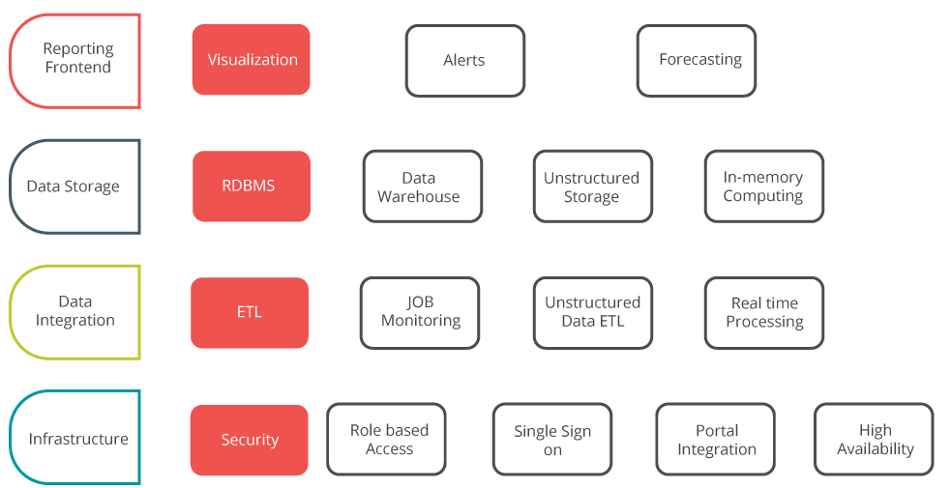
Example-Application Architecture
Maturity Level 1 (Ad-hoc reporting)
Minimal Technology Capabilities
Infrastructure-Simple password based login to reporting system
Data Integration-Primitive data integration capabilities, handful of ETL jobs running without monitoring/error handling
Storage-Simple RDBMS stores for staging/production environments
Reporting-Static dashboards that lack interactive capabilities such as drill-down reporting, parametric analysis
Ideal for
Tracking basic count-based metrics
Data limited to small number of silos(usually 2/3)
Companies only just starting out on their measurement journeys

Slide 14
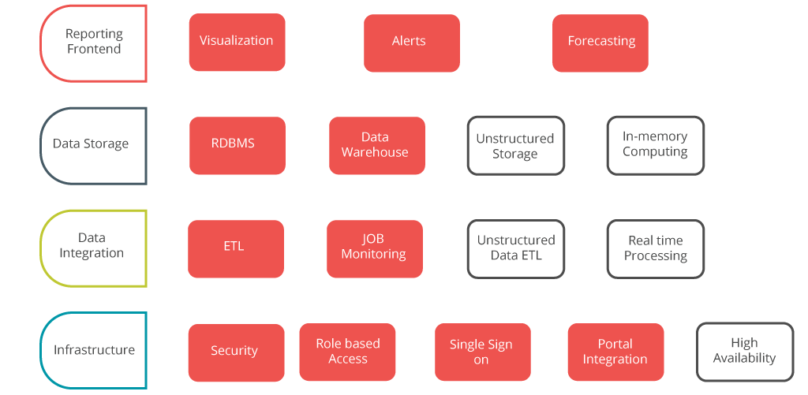
Example-Application Architecture
Maturity Level 4 (Forecasting and Simulation)
Complex BI needs
Infrastructure-Need to support multiple teams/roles with varying information needs
Data Integration-Complex data transformation requirements covering multiple teams, campaigns, and geographies
Storage-Need to support complex, and ad-hoc drill-down reporting queries on large volumes of historical data
Reporting-Need support for advanced reporting patterns (what-if analysis, differential reporting, heat-maps, forecasting etc.)
Suited for
Requirement to track operational metrics and business outcomes. Need for ad-hoc, drill down reporting
Data scattered in multiple silos

Slide 15
Reference Vs. Application Architecture
Maturity level 1
(Ad-hoc reporting on count based metrics)
Maturity level 2
(Advanced reporting needs )
Reference Architecture (R)
Application Architecture (A)
Reference Architecture (R)
Application Architecture (B)
Same
Different

Slide 16
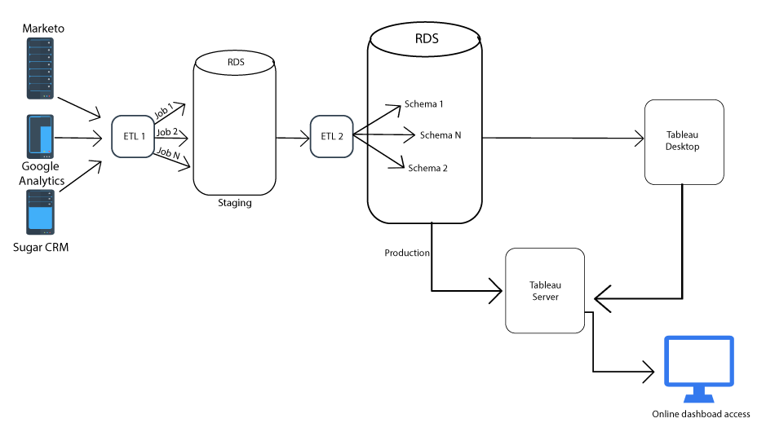
Solution Architecture
Connecting applications for specific business needs

Slide 17
Technology/Business Alignment
Steps to create Business aligned Digital Measurement architectures
Maintain a Reference Architecture
Strategic wish list of all possible capabilities
Create an Application Architecture
List of capabilities deemed apt for a particular maturity level
Create Solution Architecture
Final Solution using tools selected in Application Architecture
Select tool to be used for each capability
Specific tools not selected at this stage
Tools and capabilities outside Application Architecture may not be used
Does not specify how these tools are connected

Slide 18
Developing Digital Measurement Technology Strategies
How can we help?
Catalog immediate, mid-term(6/9 month), long term(12-24 months)
Business requirements specific to Digital Measurement
1
Create detailed Application Architecture for each phase including capturing granular technology capabilities required
2
Vendor selection services
3

